Slide 1

UECS3213 / UECS3453 Data Mining Topic 5b: Anomaly Detection
Dr. Simon Lau Boung Yew

Slide 2
Course Learning Outcomes
CO1: Identify the key technological foundations of data mining
CO2: Create programming solutions using data mining techniques for given problem
CO3: Evaluate performance of data mining solutions for a given problem
CO4: Construct a data mining project as a team
CO5: Recognize the importance of data mining techniques and its applications in the industry

Slide 3
Outline
What is Cluster Analysis?
Applications of Cluster Analysis
Types of Clustering
Hierarchical Clustering
Partitional Clustering
Types of Clusters
Clustering Algorithms
Anomaly / Outlier Detection
Causes of Anomalies
Distinction Between Noise and Anomalies
Model-Based Anomaly Detection
Anomaly Detection Techniques
Proximity-based
Density-based
Pattern matching

Slide 4
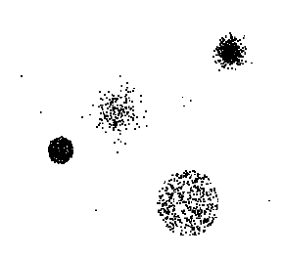
Anomaly/Outlier Detection
What are anomalies/outliers? 不规则
The set of data points that are considerably different than the remainder of the data
Natural implication is that anomalies are relatively rare
One in a thousand occurs often if you have lots of data
Context is important, e.g., freezing temps in July
Can be important or a nuisance (meaningless)
10 foot tall 2 year old
Unusually high blood pressure

Slide 5
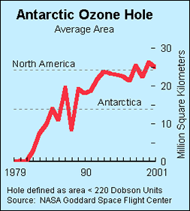
Importance of Anomaly Detection
Ozone Depletion History
In 1985 three researchers (Farman, Gardinar and Shanklin) were puzzled by data gathered by the British Antarctic Survey showing that ozone levels for Antarctica had dropped 10% below normal levels
Why did the Nimbus 7 satellite, which had instruments aboard for recording ozone levels, not record similarly low ozone concentrations?
The ozone concentrations recorded by the satellite were so low they were being treated as outliers by a computer program and discarded!
Sources: http://exploringdata.cqu.edu.au/ozone.html http://www.epa.gov/ozone/science/hole/size.html

Slide 6
Causes of Anomalies
Data from different classes
Measuring the weights of oranges, but a few grapefruit are mixed in
Natural variation (e.g. gene mutation, cosmic radiation etc.)
Unusually tall people
Data errors
200 pound 2 year old

Slide 7
Distinction Between Noise and Anomalies
Noise is erroneous, perhaps random, values or contaminating objects
Weight recorded incorrectly
Grapefruit mixed in with the oranges
Noise doesn’t necessarily produce unusual values or objects
Noise is not interesting
Anomalies may be interesting if they are not a result of noise
Noise and anomalies are related but distinct concepts

Slide 8
General Issues: Number of Attributes
Many anomalies are defined in terms of a single attribute
Height
Shape
Color
Can be hard to find an anomaly using all attributes
Noisy or irrelevant attributes
Object is only anomalous with respect to some attributes
However, an object may not be anomalous in any one attribute

Slide 9
General Issues: Anomaly Scoring
Many anomaly detection techniques provide only a binary categorization
An object is an anomaly or it isn’t (Yes/No)
This is especially true of classification-based approaches
Other approaches assign a score to all points
This score measures the degree to which an object is an anomaly
This allows objects to be ranked
In the end, you often need a binary decision
Should this credit card transaction be flagged?
Still useful to have a score
How many anomalies are there?

Slide 10
Other Issues for Anomaly Detection
Methods: Find all anomalies at once or one at a time
Swamping: one outlier swamps a second observation, if the latter can be considered as an outlier only under the presence of the first one.
Masking: one outlier masks a second outlier, if the second outlier can be considered as an outlier only by itself, but not in the presence of the first outlier.
Evaluation
How do you measure performance?
Supervised vs. unsupervised situations
Efficiency
Context
Professional basketball team vs ordinary man: how tall is considered exceptionally tall?
Notes:
http://www.eng.tau.ac.il/~bengal/outlier.pdf

Slide 11
Variants of Anomaly Detection Problems
Given a data set D, find all data points x ∈ D with anomaly scores greater than some threshold t
Given a data set D, find all data points x ∈ D having the top-n largest anomaly scores
Given a data set D, containing mostly normal (but unlabeled) data points, and a test point x, compute the anomaly score of x with respect to D

Slide 12
Model-Based Anomaly Detection
Build a model for the data and see
Unsupervised
Anomalies are those points that don’t fit well in the model
Anomalies are those points that distort the model
Examples:
Statistical distribution
Clusters
Regression
Geometric
Graph
Supervised (e.g. clustering)
Anomalies are regarded as a rare class
Need to have training data

Slide 13
Additional Anomaly Detection Techniques
Proximity-based
Anomalies are points far away from other points
Can detect this graphically in some cases (spatial visualization)
Density-based
Low density points are outliers
Pattern matching
Create profiles or templates of atypical (not normal) but important events or objects
Algorithms to detect these patterns are usually simple and efficient

Slide 14
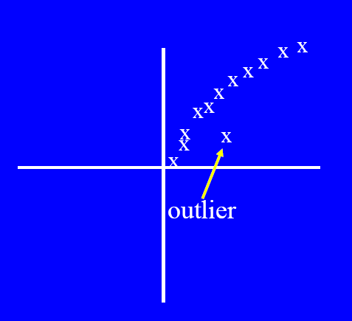
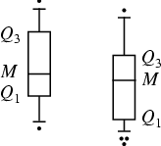
Visual Approaches
Boxplots or scatter plots
Limitations
Not automatic (need manual work)
Subjective

Slide 15
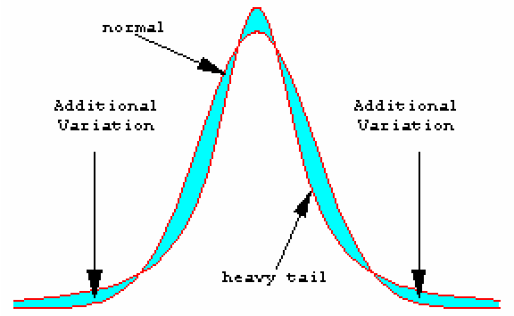
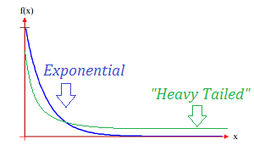
Statistical Approaches
Probabilistic definition of an outlier: An outlier is an object that has a low probability with respect to a probability distribution model of the data.
Usually assume a parametric model describing the distribution of the data (e.g., normal distribution)
Apply a statistical test that depends on
Data distribution
Parameters of distribution (e.g., mean, variance)
Number of expected outliers (confidence limit)
Issues
Identifying the distribution of a data set
Heavy tailed distribution
Number of attributes
Is the data a mixture of distributions?
Notes:
In statistics, a parametric model or parametric family or finite-dimensional model is a family of distributions that can be described using a finite number of parameters.
https://www.statisticshowto.datasciencecentral.com/heavy-tailed-distribution/
A heavy tailed distribution has a tail that’s heavier than an exponential distribution (Bryson, 1974). In other words, a distribution that is heavy tailed goes to zero slower than one with heavy tails; there will be more bulk under the curve of the PDF. Heavy tailed distributions tend to have many outliers with very high values. The heavier the tail, the larger the probability that you’ll get one or more disproportionate values in a sample.

Slide 16
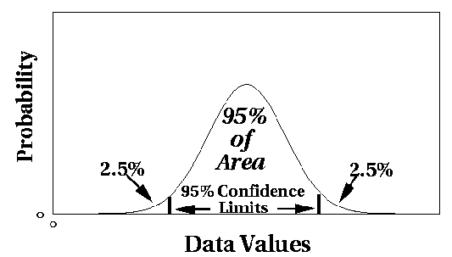
Normal Distributions
One-dimensional Gaussian
Two-dimensional Gaussian

Slide 17
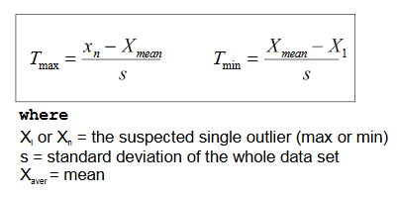
Grubbs’ Test
Detect outliers in univariate data
The test is based on the difference of the mean of the sample and the most extreme data considering the standard deviation
Assume data comes from normal distribution
Detects one outlier at a time, remove the outlier, and repeat
H₀: There is no outlier in data (null hypothesis)
H_{A}: There is at least one outlier (alternative hypothesis)
Notes:
https://en.wikipedia.org/wiki/Grubbs%27_test_for_outliers
http://www.sediment.uni-goettingen.de/staff/dunkl/software/pep-grubbs.pdf
http://statweb.stanford.edu/~jtaylo/courses/stats202/restricted/notes/outlier.pdf

Slide 18
Grubbs’ Test: Find the G Test Statistic
Order the data points from smallest to largest.
Find the mean (x̄) and standard deviation of the data set.
Calculate the G test statistic using equation:
Grubbs’ test statistic, G_{test}:
G critical value. G_{critical}:
G_{test} < G_{critical}: keep the point in the data set; it is not an outlier. G_{test} > G_{critical}: reject the point. It is an outlier.
Notes:
https://www.statisticshowto.datasciencecentral.com/grubbs-test/

Slide 19
Statistical-based – Likelihood Approach
Assume the data set D contains samples from a mixture of two probability distributions:
M (majority distribution) : “most of the data.”
A (anomalous distribution): “outlier” distribution
Data distribution, D = (1 – λ) M + λ A

Slide 20

Statistical-based – Likelihood Algorithm
General Approach:
Initially, assume all the data points belong to M
Let L_{t}(D) be the log likelihood of D at time t
For each point x_{t} that belongs to M, move it to A
Let L_{t+1} (D) be the new log likelihood.
Compute the difference, Δ = L_{t}(D) – L_{t+1} (D)
If Δ > c (some threshold), then x_{t} is declared as an anomaly and moved permanently from M to A
Notes:
https://www.statlect.com/glossary/log-likelihood
given a sample and a parametric family of distributions (i.e., a set of distributions indexed by a parameter) that could have generated the sample, the likelihood is a function that associates to each parameter the probability (or probability density) of observing the given sample.

Slide 21
Statistical-based – Likelihood Approach
M is a probability distribution estimated from data
Can be based on any modeling method (naïve Bayes, maximum entropy, etc)
A is initially assumed to be uniform distribution
Likelihood at time t:

Slide 22
Strengths/Weaknesses of Statistical Approaches
Firm mathematical foundation
Can be very efficient
Good results if distribution is known. In many cases, data distribution may not be known
For high dimensional data, it may be difficult to estimate the true distribution.
Anomalies can distort the parameters of the distribution.

Slide 23
Distance-Based Approaches
An object is an outlier if a specified fraction of the objects is more than a specified distance away (Knorr, Ng 1998)
Some statistical definitions are special cases of this
The outlier score of an object is the distance to its k-th nearest neighbor

Slide 24
One Nearest Neighbor - One Outlier
Outlier Score

Slide 25
One Nearest Neighbor - Two Outliers
Outlier Score

Slide 26
Five Nearest Neighbors - Small Cluster
Outlier Score

Slide 27
Five Nearest Neighbors - Differing Density
outliers?
outliers?
Outlier Score

Slide 28
Strengths/Weaknesses of Distance-Based Approaches
Simple
Computationally expensive – O(n²)
Sensitive to parameters
Sensitive to variations in density
Distance becomes less meaningful in high-dimensional space

Slide 29
Density-Based Approaches
Density-based Outlier: The outlier score of an object is the inverse of the density around the object.
Can be defined in terms of the k nearest neighbors
One definition: Density is the inverse of distance to k-th neighbor
Another definition: Density is the inverse of the average distance to k neighbors
DBSCAN definition
If there are regions of different density, this approach can have problems

Slide 30
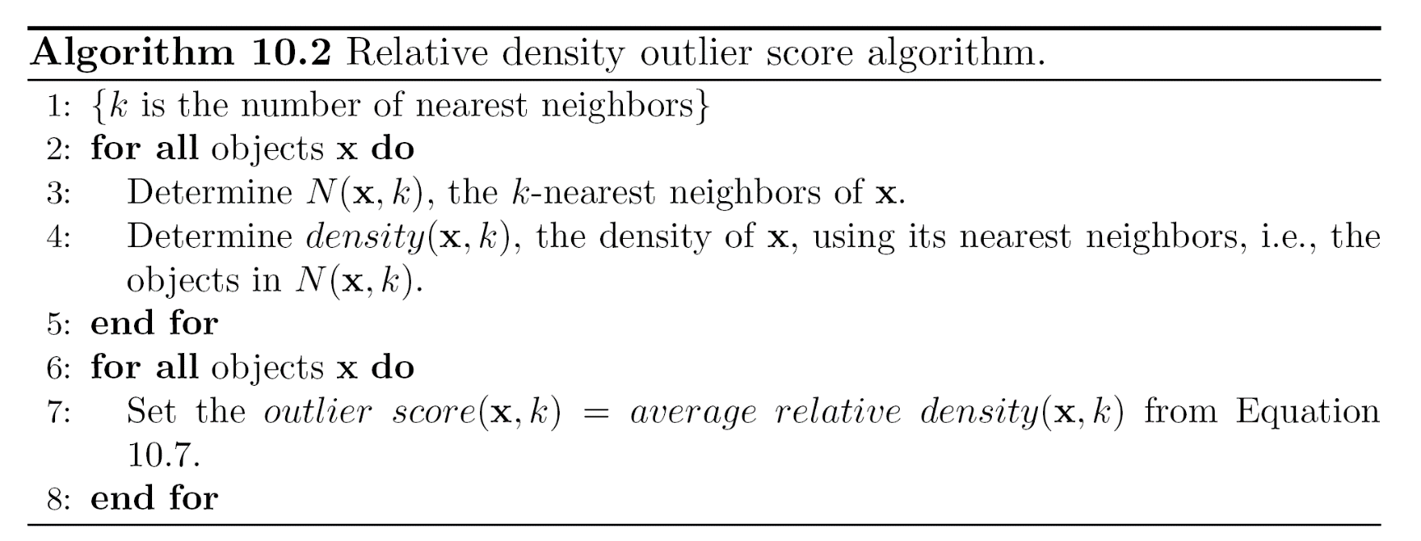
Relative Density
Consider the density of a point relative to that of its k nearest neighbors

Slide 31
Relative Density Outlier Scores
Outlier Score

Slide 32
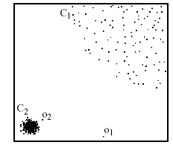
Density-based: LOF approach
For each point, compute the density of its local neighborhood
Compute local outlier factor (LOF) of a sample p as the average of the ratios of the density of sample p and the density of its nearest neighbors
Outliers are points with largest LOF value
In the NN approach, p₂ is not considered as outlier, while LOF approach find both p₁ and p₂ as outliers
p₂
×
p₁
×

Slide 33
Strengths/Weaknesses of Density-Based Approaches
Simple
Expensive – O(n²)
Sensitive to parameters
Density becomes less meaningful in high-dimensional space

Slide 34
Clustering-Based Approaches
Clustering-based Outlier: An object is a cluster-based outlier if it does not strongly belong to any cluster
For prototype-based clusters, an object is an outlier if it is not close enough to a cluster center
For density-based clusters, an object is an outlier if its density is too low
For graph-based clusters, an object is an outlier if it is not well connected
Other issues include the impact of outliers on the clusters and the number of clusters

Slide 35
Distance of Points from Closest Centroids
Outlier Score

Slide 36
Relative Distance of Points from the Closest Centroid
Outlier Score

Slide 37
Strengths/Weaknesses of Distance-Based Approaches
Simple
Many clustering techniques can be used
Can be difficult to decide on a clustering technique
Can be difficult to decide on number of clusters
Outliers can distort the clusters

Slide 38
Conclusion
Clustering is a “black art”.
In Chapter 5, we have learned about
Types of clusters
Clustering techniques:
Partitional Clustering
K-Means
Hierarchical Clustering
Agglomerative
Anomaly Detection Techniques
No any single technique is a cure for all problems. The choice of technique depends on the data and the application.

Slide 39
Main References
Harrington, P (2012). Machine Learning in Action. Manning Publications.
Richert, W. and Coelho, L.P. (2013). Building Machine Learning Systems with Python. Packt Publishing.
Witten, I.H, Franck, E, and Hall, M. A. (2011). Data Mining: Practical Machine Learning Tools and Techniques. (3rd ed.). Morgan Kaufmann.
Pang-Ning Tan, Michael Steinbach, Anuj Karpatne, Vipin Kumar (2018). Introduction to Data Mining (2nd Edition), Pearson

Slide 40
Other References
J. Grus (2015). Data Science from Scratch: First Principles with Python. O'Reilly Media.
C. C. Aggarwal. (2015). Data Mining: The Textbook. Springer
Richert, W. and Coelho, L.P. (2013). Building Machine Learning Systems with Python. Packt Publishing.
Russel M.A. (2013). Mining the Social Web: Data Mining Facebook, Twitter, LinkedIn, Google+, GitHub, and More. (2nd Ed). O’Reilly Media.

Slide 41
Online References
https://chih-ling-hsu.github.io/2017/09/01/Clustering

